Slide 1
SSZG 518: Database Design and Applications
Today’s Class
Concurrency Control
Crash Recovery

Slide 2
Timesstamp- Based Protocols
Each transaction is issued a timestamp when it enters the system. If an older transaction T_{i} has time-stamp TS(T_{i}), a younger transaction T_{j} is assigned time-stamped TS(T_{j}) such that TS(T_{i}) < TS(T_{j}).
The protocol manages concurrent execution such that the time-stamps determine the serializability order.
For each data item Q, two timestamps are maintained:
W-timestamp(Q) is the largest time-stamp of any transaction that executed write(Q) successfully.
R- timestamp(Q) is the largest time-stamp of any transaction that executed read(Q) successfully.
Data
items
TS(T1)
W-TS(Q), R-TS(Q)
T1
W-TS(R), R-TS(R)
TS(T2)
T2
W-TS(S), R-TS(S)

Slide 3
Timestamp-Based Protocol
The timestamp ordering protocol ensures that any conflicting read and write operations are executed in timestamp order.
Suppose a transaction T_{i} issues a read(Q)
If TS(T_{i}) < W-timestamp(Q)
T_{i} wants to read a value of Q that has been written by a “younger” transaction
Hence, the read operation is rejected, and T_{i} is rolled back.
If TS(T_{i}) ≥ W-timestamp(Q)
then the read operation is executed
R-timestamp(Q) is set to the maximum of R-timestamp(Q) and TS(T_{i}).

Slide 4
Timestamp-Based Protocol
Suppose that transaction T_{i} issues write(Q).
If TS(T_{i}) < R-timestamp(Q)
Q is already read by a “younger” transaction
if T_{i} writes to Q, then it may conflict with this younger transaction
Hence, the write operation is rejected, and T_{i} is rolled back.
If TS(T_{i}) < W-timestamp(Q)
T_{i} is attempting to write an obsolete value of Q since a “newer” value has already been written onＱ
Hence, this write operation is rejected, and T_{i} is rolled back.
Otherwise, the write operation is executed, and W-timestamp(Q) is set to TS(T_{i}).

Slide 5
Example Use of the Protocol
A partial schedule for transactions with timestamp 1, 2, 3, 4, 5
T1
T2
T3
T4
T5
Read(X)
Read(Y)
√
√
Read(Y)
√
Write(Y)
√
Write(Z)
x
Read(Z)
Read(Z)
√
√
abort
x
Read(X)
√
Write(Z)
abort
Write(X)
Write(Z)
Aborted transactions are restarted with new timestamps

Slide 6
Correctness of Timestamp-Ordering Protocol
The timestamp-ordering protocol guarantees serializability since all the arcs in the precedence graph are of the form:
Thus, there will be no cycles in the precedence graph
Timestamp protocol ensures freedom from deadlock as no transaction ever waits.
But the schedule may not be cascade-rollback-free, and may not even be recoverable.
Transaction
with smaller/older
timestamp
Transaction
with larger/younger
timestamp

Slide 7
Recoverability and Cascade Freedom
Problem with timestamp-ordering protocol:
Suppose T_{i} aborts, but T_{j} has read a data item written by T_{i}
Then T_{j} must abort; if T_{j} had been allowed to commit earlier, the schedule is not recoverable.
Further, any transaction that has read a data item written by T_{j} must abort
This can lead to cascading rollback --- that is, a chain of rollbacks
Solution 1:
A transaction is structured such that its writes are all performed at the end of its processing
All writes of a transaction form an atomic action; no transaction may execute while a transaction is being written
A transaction that aborts is restarted with a new timestamp
Solution 2: Limited form of locking: wait for data to be committed before reading it
Solution 3: Use commit dependencies to ensure recoverability

Slide 8
Thomas’ Write Rule
Modified version of the timestamp-ordering protocol in which obsolete write operations may be ignored under certain circumstances.
When T_{i} attempts to write data item Q, if TS(T_{i}) < W-timestamp(Q), then T_{i} is attempting to write an obsolete value of {Q}.
Rather than rolling back T_{i} as the timestamp ordering protocol would have done, this {write} operation can be ignored.
Otherwise this protocol is the same as the timestamp ordering protocol.
Thomas' Write Rule allows greater potential concurrency.
Allows some view-serializable schedules that are not conflict-serializable.

Slide 9
Dealing with Deadlock
Deadlocks tend to be rare, and involve only a few transactions
Common approach:
Lock manager maintains “waits-for” graph, and periodically checks for cycles
If a cycle is detected, abort some transaction to break the cycle (and relinquish its locks)
If a transaction doesn’t complete within some fixed amount of time, assume it is deadlocked, and abort
Also deadlock prevention techniques

Slide 10
Deadlock Handling
Consider the following two transactions:
T₁: write (X) T₂: write(Y)
write(Y) write(X)
Schedule with deadlock
T₁
T₂
lock-X on X
write (X)
lock-X on Y
write (X)
wait for lock-X on X
wait for lock-X on Y

Slide 11
Deadlock Handling
System is deadlocked if there is a set of transactions such that every transaction in the set is waiting for another transaction in the set.
Deadlock prevention protocols ensure that the system will never enter into a deadlock state.
Deadlock detection & recovery: protocols allow system to enter into a deadlock, detect them as quickly as possible & recover from it by rolling back one or more txs.

Slide 12
Deadlock Handling
Deadlock prevention protocols ensure that the system will never enter into a deadlock state. Some prevention strategies :
Require that each transaction locks all its data items before it begins execution (predeclaration).
Impose partial ordering of all data items and require that a transaction can lock data items only in the order specified by the partial order (graph-based protocol).

Slide 13
More Deadlock Prevention Strategies
Following schemes use transaction timestamps for the sake of deadlock prevention alone.
wait-die scheme — non-preemptive
older transaction may wait for younger one to release data item. Younger transactions never wait for older ones; they are rolled back instead.
a transaction may die several times before acquiring needed data item
wound-wait scheme — preemptive
older transaction wounds (forces rollback) of younger transaction instead of waiting for it. Younger transactions may wait for older ones.
may be fewer rollbacks than wait-die scheme.

Slide 14
Deadlock Prevention - Timestamps
When T_{i} wants an item locked by T_{j,} one of the following two rules can be used to avoid deadlock:
wait-die rule: if TS(T_{i}) < TS(T_{j})
T_{i} waits else T_{i} aborts and restarts with same TS
wound-die rule: if TS(T_{i}) < TS(T_{j}) T_{j} aborts and restarts with same TS else T_{i} waits
Prevent deadlocks but abort transactions which are not in deadlock
A transaction my be aborted many times because an older transaction holds an item for a long period of time (need delay in restart)
Restarted transactions retain their original “seniority” to avoid starvation

Slide 15
Deadlock prevention (Cont.)
Both in wait-die and in wound-wait schemes, a rolled back transactions is restarted with its original timestamp. Older transactions thus have precedence over newer ones, and starvation is hence avoided.
Timeout-Based Schemes :
a transaction waits for a lock only for a specified amount of time. After that, the wait times out and the transaction is rolled back.
thus deadlocks are not possible
simple to implement; but starvation is possible. Also difficult to determine good value of the timeout interval.

Slide 16
Deadlock Detection Techniques
Transactions are allowed to proceed freely, but system periodically checks if deadlock has occurred and fixes it if deadlock is detected
Good for short transactions that lock only a few items
Method: construct a wait-for graph by drawing an edge from T_{i} to T_{j} if T_{i} is waiting for an item locked by T_{j}
Problems:
How often should the system checks deadlock?
If a deadlock is detected, which transaction should be aborted? (should select short transactions involved in multiple deadlocks)
Cyclic restart: when a transaction is aborted and restarted, it is involved in another deadlock (e.g., due to transactions accessing same data items with the same pattern); random delays can be introduced in restart

Slide 17
Deadlock Detection
Deadlocks can be described as a wait-for graph, which consists of a pair G = (V,E),
V is a set of vertices (all the transactions in the system)
E is a set of edges; each element is an ordered pair T_{i} →T_{j}.
If T_{i} → T_{j} is in E, then there is a directed edge from T_{i} to T_{j}, implying that T_{i} is waiting for T_{j} to release a data item.
When T_{i} requests a data item currently being held by T_{j}, then the edge T_{i} T_{j} is inserted in the wait-for graph. This edge is removed only when T_{j} is no longer holding a data item needed by T_{i}.
The system is in a deadlock state if and only if the wait-for graph has a cycle. Must invoke a deadlock-detection algorithm periodically to look for cycles.

Slide 18
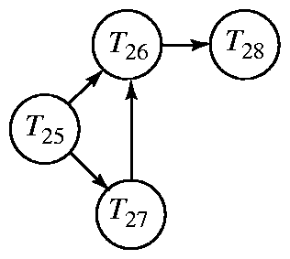
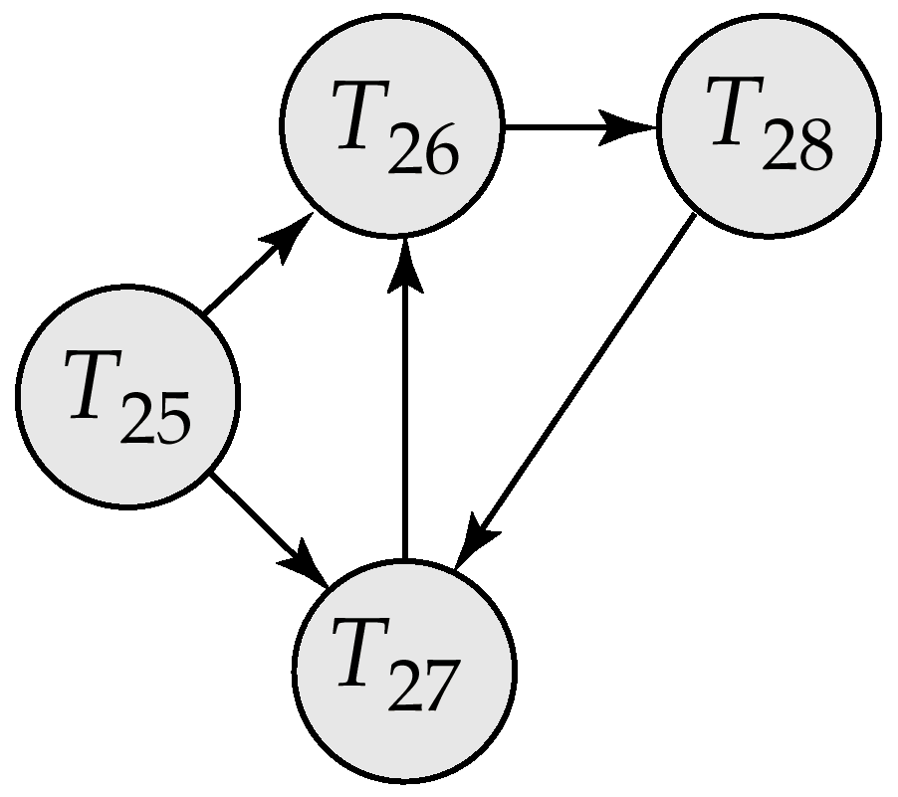
Deadlock Detection (Cont.)
Wait-for graph without a cycle
Wait-for graph with a cycle

Slide 19
Deadlock Detection (Continued)
Example:
T1: S(A), R(A), S(B)
T2: X(B),W(B) X(C)
T3: S(C), R(C) X(A)
T4: X(B)
T1
T2
T1
T2
T4
T3
T3
T3

Slide 20
Deadlock Recovery
When deadlock is detected :
Some transaction will have to rolled back (made a victim) to break deadlock. Select that transaction as victim that will incur minimum cost.
Rollback -- determine how far to roll back transaction
Total rollback: Abort the transaction and then restart it.
More effective to roll back transaction only as far as necessary to break deadlock.
Starvation happens if same transaction is always chosen as victim. Include the number of rollbacks in the cost factor to avoid starvation

Slide 21
Deadlock Victim
Choose a deadlock victim based on the following parameters:
How much work the tx. has done?
How far is it from completion?
How many resources (DIs) it is holding?
How many txs. will be involved in the rollback
How many times it has been rolled back?
How many deadlocks it is involved in?

Slide 22
Topics
Crash recovery
Log-based
Immediate database modification
Deferred database modification

Slide 23
Failure Classification
Transaction failure :
Logical errors: transaction cannot complete due to some internal error condition
System errors: the database system must terminate an active transaction due to an error condition (e.g., deadlock)
System crash: a power failure or other hardware or software failure causes the system to crash.
Fail-stop assumption: non-volatile storage contents are assumed to not be corrupted by system crash
Database systems have numerous integrity checks to prevent corruption of disk data
Disk failure: a head crash or similar disk failure destroys all or part of disk storage
Destruction is assumed to be detectable: disk drives use checksums to detect failures

Slide 24
Recovery Algorithms
Recovery algorithms are techniques to ensure database consistency and transaction atomicity and durability despite failures
Recovery algorithms have two parts
Actions taken during normal transaction processing to ensure enough information exists to recover from failures
Actions taken after a failure to recover the database contents to a state that ensures atomicity, consistency and durability

Slide 25
Storage Structure
Volatile storage:
does not survive system crashes
examples: main memory, cache memory
Nonvolatile storage:
survives system crashes
examples: disk, tape, flash memory, non-volatile (battery backed up) RAM
but may still fail, losing data
Stable storage:
a mythical form of storage that survives all failures
approximated by maintaining multiple copies on distinct nonvolatile media

Slide 26
Data Access
Physical blocks are those blocks residing on the disk.
Buffer blocks are the blocks residing temporarily in main memory.
Block movements between disk and main memory are initiated through the following two operations:
input(B) transfers the physical block B to main memory.
output(B) transfers the buffer block B to the disk, and replaces the appropriate physical block there.
Each transaction T_{i} has its private work-area in which local copies of all data items accessed and updated by it are kept.
T_{i}'s local copy of a data item X is called x_{i}.
We assume, for simplicity, that each data item fits in, and is stored inside, a single block.

Slide 27
Data Access
Transaction transfers data items between system buffer blocks and its private work-area using the following operations :
read(X) assigns the value of data item X to the local variable x_{i}.
write(X) assigns the value of local variable x_{i} to data item {X} in the buffer block.
both these commands may necessitate the issue of an input(B_{X}) instruction before the assignment, if the block B_{X} in which X resides is not already in memory.

Slide 28
Data Access
Transactions
Perform read(X) while accessing X for the first time;
All subsequent accesses are to the local copy.
After last access, transaction executes write(X).
output(B_{X}) need not immediately follow write(X). System can perform the output operation when it deems fit.

Slide 29
Example of Data Access
buffer
Buffer Block A
x
input(A)
Buffer Block B
Y
A
output(B)
B
read(X)
write(Y)
x₂
disk
x₁
y₁
work area
of T₁
work area
of T₂
memory

Slide 30
Recovery & Atomicity
Modifying the database without ensuring that the transaction will commit may leave the database in an inconsistent state.
Consider transaction T_{i} that transfers $50 from account A to account B; goal is either to perform all database modifications made by T_{i} or none at all.
Several output operations may be required for T_{i} (to output A and B). A failure may occur after one of these modifications have been made but before all of them are made.

Slide 31
Recovery & Atomicity
To ensure atomicity despite failures, we first output information describing the modifications to stable storage without modifying the database itself.
We study two approaches:
log-based recovery, and
shadow-paging
We assume (initially) that transactions run serially, that is, one after the other.

Slide 32
Log-Based Recovery
A log is kept on stable storage.
The log is a sequence of log records, and maintains a record of update activities on the database.
When transaction T_{i} starts, it registers itself by writing a <T_{i} start>log record
Before T_{i} executes write(X), a log record <T_{i}, X, V₁, V₂> is written, where V₁ is the value of X before the write, and V₂ is the value to be written to X.
Log record notes that T_{i} has performed a write on data item X_{j} X_{j} had value V₁ before the write, and will have value V₂ after the write.
When T_{i} finishes it last statement, the log record <T_{i} commit> is written.
We assume for now that log records are written directly to stable storage (that is, they are not buffered)

Slide 33
Log-Based Recovery
Two approaches using logs:
Deferred database modification
Immediate database modification

Slide 34
Deferred Database Modification
The deferred database modification scheme records all modifications to the log, but defers all the writes to after partial commit.
Assume that transactions execute serially
Transaction starts by writing <T_{i} start> record to log.
A write(X) operation results in a log record <T_{i}, X, V> being written, where V is the new value for X
Note: old value is not needed for this scheme
The write is not performed on X at this time, but is deferred.
When T_{i} partially commits, <T_{i} commit> is written to the log
Finally, the log records are read and used to actually execute the previously deferred writes.

Slide 35
Deferred Database Modification
During recovery after a crash, a transaction needs to be redone if and only if both <T_{i} start> and<T_{i} commit> are there in the log.
Redoing a transaction T_{i} ( redoT_{i}) sets the value of all data items updated by the transaction to the new values.
Crashes can occur while
the transaction is executing the original updates, or
while recovery action is being taken
example transactions T₀ and T₁ (T₀ executes before T₁):
T₀: read (A) T₁ : read (C)
A: - A - 50 C:-C- 100
Write (A) write (C)
read (B)
B:- B + 50
write (B)

Slide 36
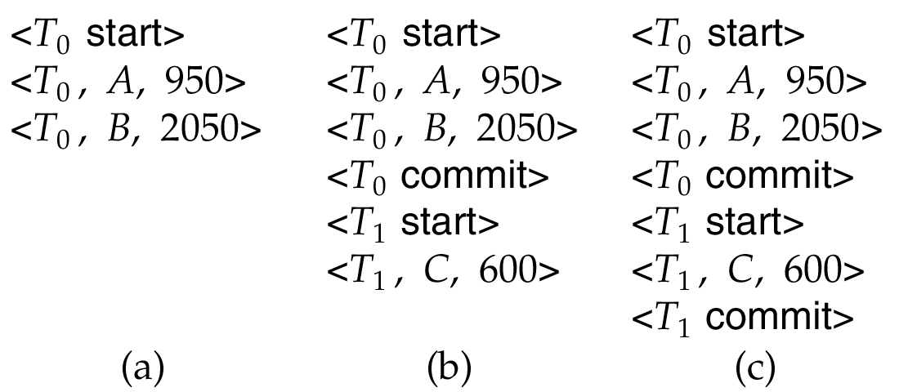
Deferred Database Modification
Below we show the log as it appears at three instances of time.
If log on stable storage at time of crash is as in case:
(a) No redo actions need to be taken
(b) redo(T₀) must be performed since <T₀ commit> is present
(c) redo(T₀) must be performed followed by redo(T₁) since
<T₀ commit> and <T_{i} commit> are present

Slide 37
Immediate Database Modification
The immediate database modification scheme allows database updates of an uncommitted transaction to be made as the writes are issued
since undoing may be needed, update logs must have both old value and new value
Update log record must be written before database item is written
We assume that the log record is output directly to stable storage
Can be extended to postpone log record output, so long as prior to execution of an output(B) operation for a data block B, all log records corresponding to items B must be flushed to stable storage

Slide 38
Immediate Database Modification
Output of updated blocks can take place at any time before or after transaction commit
Order in which blocks are output can be different from the order in which they are written.

Slide 39
Immediate Database Modification Example
Log Write Output
<T₀ start>
<T₀, A, 1000, 950>
<T_{o}, B, 2000, 2050>
A = 950
B = 2050
<T₀ commit>
<T₁ start>
<T₁, C, 700, 600>
C = 600
B_{B}, B_{C}
<T₁ commit>
B_{A}
Note: B_{X} denotes block containing X.

Slide 40
Immediate Database Modification
Recovery procedure has two operations instead of one:
undo(T_{i}) restores the value of all data items updated by T_{i} to their old values, going backwards from the last log record for T_{i}
redo(T_{i}) sets the value of all data items updated by T_{i} to the new values, going forward from the first log record for T_{i}
Both operations must be idempotent
That is, even if the operation is executed multiple times the effect is the same as if it is executed once
Needed since operations may get re-executed during recovery

Slide 41
Immediate Database Modification
When recovering after failure:
Transaction T_{i} needs to be undone if the log contains the record <T_{i} start>, but does not contain the record <T_{i} commit>.
Transaction T_{i} needs to be redone if the log contains both the record <T_{i} start> and the record <T_{i} commit>.
Undo operations are performed first, then redo operations.

Slide 42
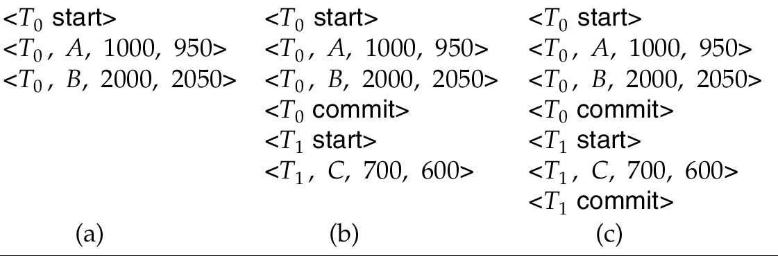
Immediate DB Modification Recovery Example
Below we show the log as it appears at three instances of time.
Recovery actions in each case above are:
(a) undo (T₀): B is restored to 2000 and A to 1000.
(b) undo (T₁) and redo (T₀): C is restored to 700, and then A and B are set to 950 and 2050 respectively.
(c) redo (T₀) and redo (T₁): A and B are set to 950 and 2050
respectively. Then C is set to 600

Slide 43
Checkpoints
Problems in recovery procedure as discussed earlier :
searching the entire log is time-consuming
we might unnecessarily redo transactions which have already output their updates to the database.
Streamline recovery procedure by periodically performing checkpointing
Output all log records currently residing in main memory onto stable storage.
Output all modified buffer blocks to the disk.
Write a log record < checkpoint> onto stable storage.

Slide 44
Checkpoints
During recovery we need to consider only the most recent transaction T_{i} that started before the checkpoint, and transactions that started after T_{i}.
Scan backwards from end of log to find the most recent <checkpoint> record
Continue scanning backwards till a record <T_{i} start> is found.
Need only consider the part of log following above start record. Earlier part of log can be ignored during recovery, and can be erased whenever desired.
For all transactions (starting from T_{i} or later) with no <T_{i} commit>, execute undo(T_{i}). (Done only in case of immediate modification.)
Scanning forward in the log, for all transactions starting from T_{i} or later with a <T_{i} commit>, execute redo(T_{i}).

Slide 45
Example of Checkpoints
T₁ can be ignored (updates already output to disk due to checkpoint)
T₂ and T₃ redone.
T₄ undone
T_{c}
T_{f}
T₁
T₂
T₃
T₄
checkpoint
system failure

